Slide 1
Neural Networks for Knee MRI classification
Michael Applbaum
Yaakov Applbaum MD

Slide 2
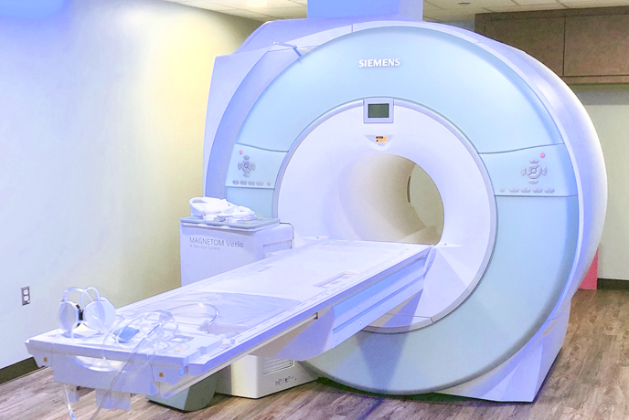
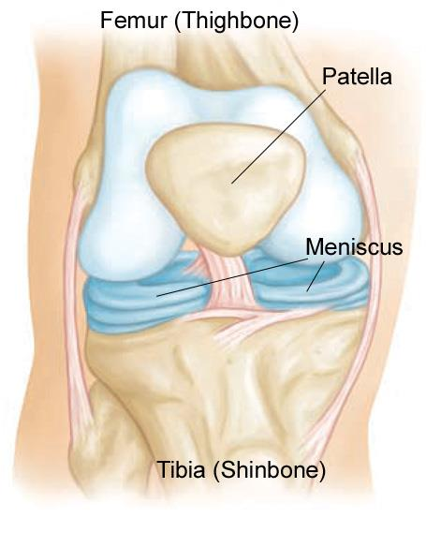
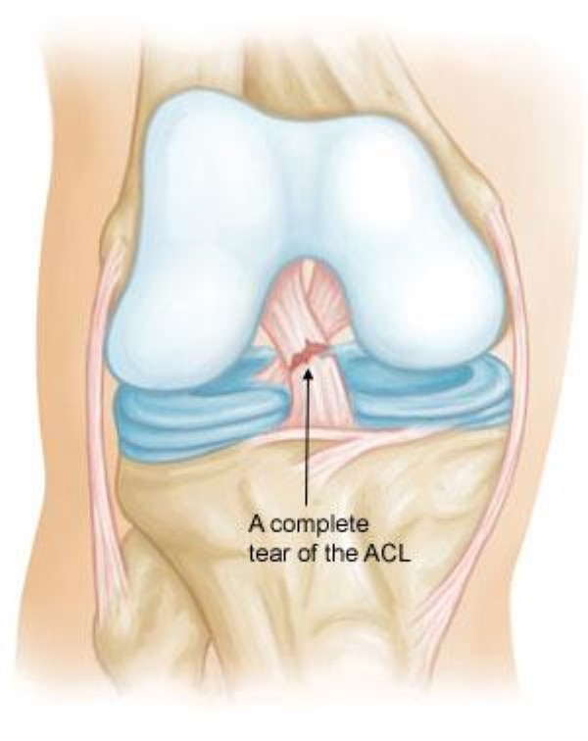
Background
MRI - Magnetic Resonance Imaging
Knee problems are very common, in many cases surgical intervention is needed.
Main problems: Meniscus tear and ACL tear. 10-15% of knee MRI cases.
Notes:
תיאור קצרצר של MRI
קרע במיניסקוס –רקמת סחוס בין עצמות המחברות את הברך, יש שתי צורות שבהם יכול להווצר קרע – מידיאלי ולטרלי כלומר פנימי או חיצוני
ACL - anterior cruciate (KROO-she-ate) ligament – רקמת סיבים, קרע ברצועה הצולבת הקידמית המחברת את העצמות בברך. נפוץ אצל ספורטאים בגלל משקל רב המופעל עליהם.

Slide 3
Business problem and solution
Diagnosis of knee injuries is time consuming and expensive.
Automated solutions can free some time for doctors to examine patients with more severe and complex conditions.
Proposition:
Convolutional neural nets demonstrate outstanding accuracy scores on vision problems. For some tasks such as classification – better than humans.
to diagnose common knee injuries using CNN state of the art architectures.
This study’s goal is to test the hypothesis that neural nets can be an approach good enough to classify simple Knee MRI tasks.

Slide 4
The Data
The data and baseline model implementation were taken from Stanford University’s ‘MRnet’ competition.
Train and validation datasets are available online at this link.
Train set includes 1,130 exams and validation set 120 exams.
The Test set was obtained from Shaare Zedek Medical Center’s MRI institute and contains 20 exams. Didn’t test yet the model.
The data contains three diagnosis classes: meniscus tear(35%), ACL tear(18%) and other abnormalities(80%) marked by expert MSK radiologists.
Notes:
להדגיש שהקלאסים לא סותרים אלא הם Tasksשונים על הדאטה.
להסביר שיש כאן unbalanced dataset

Slide 5
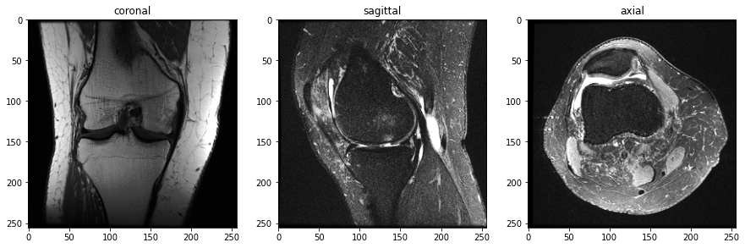
Exploratory Data Analysis
An MRI knee examination (a “study”) consists of multiple series of images each of which contains sequential scans with tissue characteristics in different planes, our dataset contains three quasi-orthogonal planes:
Each series consist of a batch of these images called slices, covering the whole knee from different angles.
In practice radiologists use all series since they hold information needed for the diagnosis.
Notes:
לציין שהפלט הוא של imshow בmatplotlib

Slide 6
Exploratory Data Analysis
MRI cases are encoded in DICOM format, which has a rich representation of gray scale.
The resolution of the images can be changed and is set by the technicians performing the exam.
The trainset was scaled to 256x256 pixels, was then transformed into png format using the ‘pydicom’ library.

Slide 7

Exploratory Data Analysis
MR images tend to have a high variance of pixel intensity. Not only between different machines but also among different studies.
There are several ways to account for pixel intensities. the one picked in the dataset is “histogram-based intensity standardization”.
Notes:
הנרמול המוצע הוא לקחת המינ' והמקס' של כל רמות האפור שיש בדאטהסט (מסומן באות S) לאחר מכן בכל תמונה למפות את המינ' מקס' של התמונה מסומן בP ואז כל פיקסל X ינורמל לפי המשוואה המוצעת שבעצם מתקננת באופן ליניארי.
יש לציין שקיימות שיטות רבות לתקנון תמונות MRI בספרות, אני מצאתי כי דווקא השיטה הנ"ל נחשבת פחות טובה, אולם זה מה שהשתמשו בו במאמר של Mrnet

Slide 8
The model
this knee dataset includes three series of images.
Each image is transformed to RGB in order to align with the model demands and are of 3xSx256x256 dimensions.
Each slice or image in the series goes through a convnet – Alexnet (2012). (Sx256x13x13)
An average pooling layer is added to reduce the features.(Sx256)
Before entering a fully connected layer at the end, a pooling among slices is executed in order to encode the signal from the most important slice. (1x256)
a fully connected layer.
Notes:
3 – RGB channel
S - slices

Slide 9
The model
The weights of the alexnet architecture were not part of the learning process. Instead, they were kept pretrained as part of the ‘transfer learning’ approach to ease the learning. I trained the whole network because the outputs weren’t great.
After training the covnet, each neural network is then weighted through a training process of a simple logistic regression in order to account for all of the information that is produced from the different planes in the study.
The process is repeated for the three two different tasks we are trying to predict. Trained only for two tasks because of runtime limitations.

Slide 10
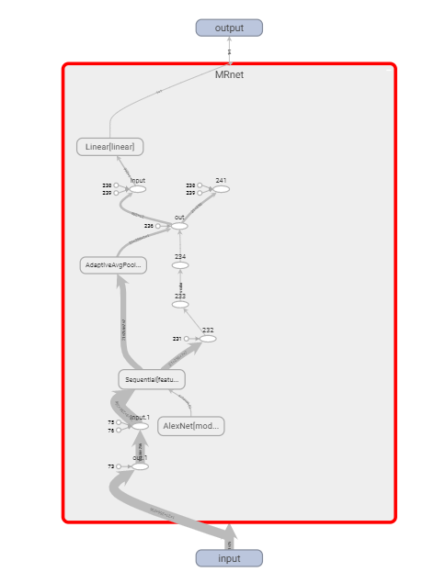
The model - recap
For each diagnostic task:
DICOM->scaling to 256->PNG->histogram standardization->RGB transformation-> Alexnet-> average pooling->max pooling over slices->fully connected layer-> sigmoid function ->weighting probabilities with a logistic regression

Slide 11
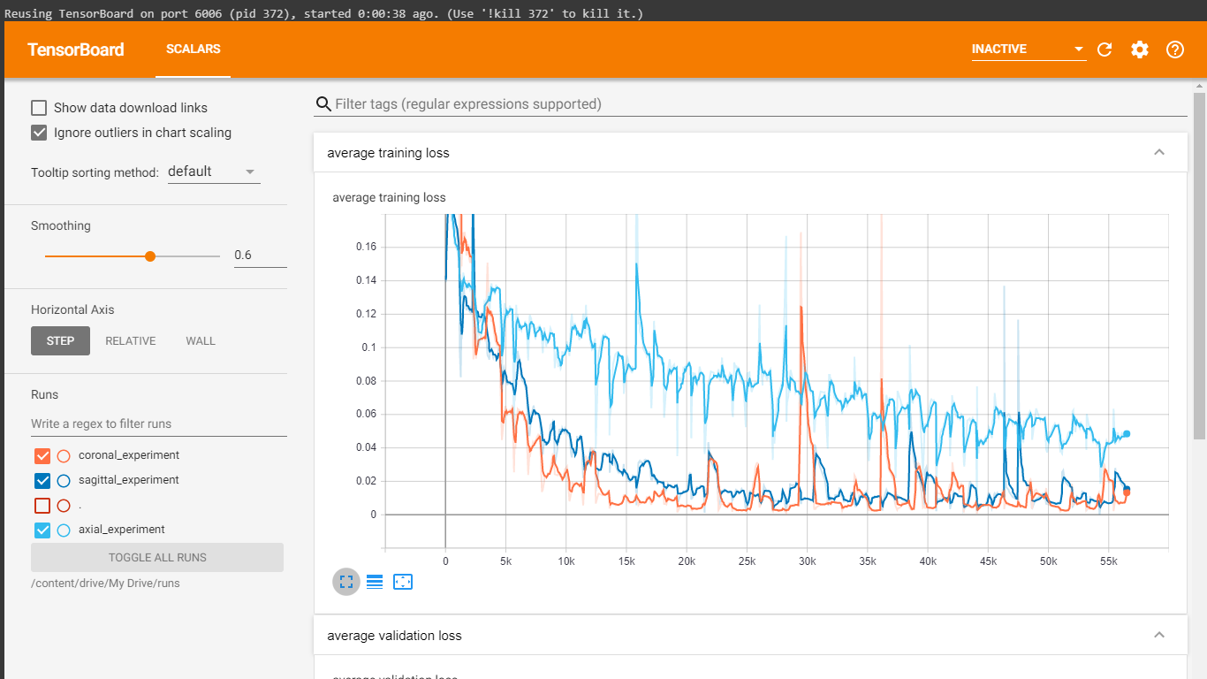
Training log on Tensorboard – ACL tear training loss

Slide 12
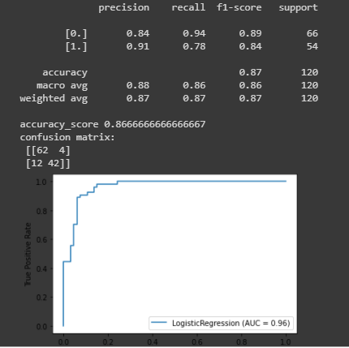
Findings – ACL tear results
Weighting all planes gave an accuracy score of 86.7% on the validation set.
The results on other metrics are not far from the articles result.

Slide 13
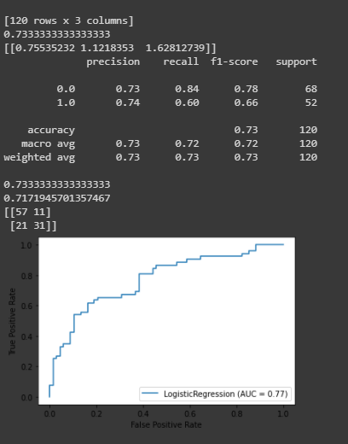
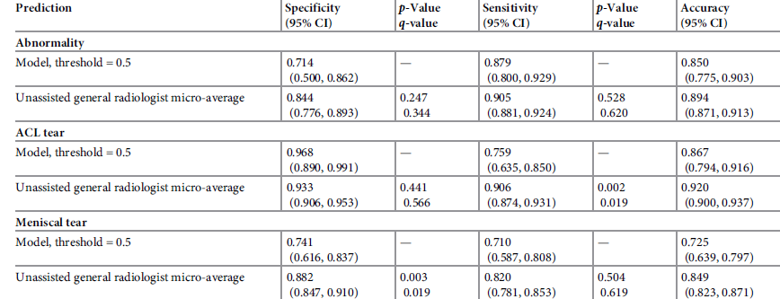
Findings – Meniscal tear results
Scores in meniscal tear are similar to those presented in the article

Slide 14
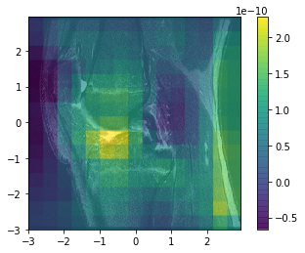
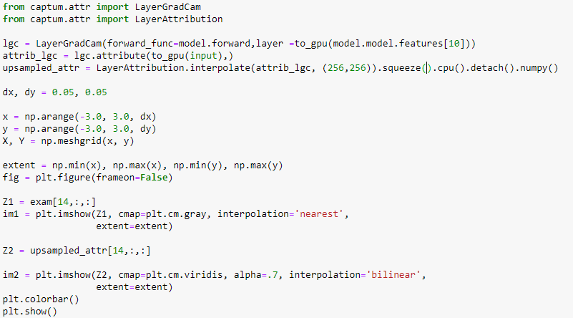
Interpretability with GradCAM
Notes:
CAM = class activation map
Computes GradCAM attribution for chosen layer. GradCAM is designed for convolutional neural networks, and is usually applied to the last convolutional layer.
GradCAM computes the gradients of the target output with respect to the given layer, averages for each output channel (dimension 2 of output), and multiplies the average gradient for each channel by the layer activations. The results are summed over all channels.
ממש בכללי – הCAM מבצע חישוב של ממוצע הגראדיאנטים האחרונים של הקונבולוציה – כלומר הוא נמצא לקראת השכבה האחרונה של הסיווג אחרי שהוא כבר בנה ייצוג שלם של התמונה

Slide 15
Discussion
Picture quality and richness that might contain important features are lost due to Network architecture compatibility.
It might be more interpretable to combine the different planes in a single representation rather than creating three stand alone networks that are added in the end of the chain.
More general thoughts: AI research is focusing on trying to replace human input in performing medical tasks, will we ever want to rely solely on AI for medical purposes? Maybe AI should focus on enhancing humans instead.
Notes:
ההערה השנייה מתייחסת לעובדה שכל מישור של התמונות מקבל רשת נפרדת שמשוקללת רק בסוף התהליך במקום לייצר יצוג אחד כולל לכל המישורים מה שבעצם אולי משקף נקודה במרחב יותר מאשר זוית הסתכלות.
לגבי התהיה האחרונה – הנפקא מינה שיוצאת ממנה היא שבמקום לעבוד על task של קלאסיפיקציה צריך לשים יותר דגש על זיהוי נקודות משמעותיות בתוך התמונה, כאלה שאולי יכוונו את הרדיולוג, יתנו לו יותר ערך, אולי יציעו כבר אבחון (ליצור אוטומציה חכמה אבל חצי אוטומטית)

Slide 16
Questions?
Thank you!

